Slide 1
Coaching when there is resistance
Longitudinal Session #2 COMSEP COACHING CERTIFICATE PROGRAM
November 2024

Slide 2
Checking in
What have you noticed as you use a coaching approach?
Is there something you want to explore today?

Slide 3
How do you sense when there might be resistance to change when using the coaching approach?

Slide 4
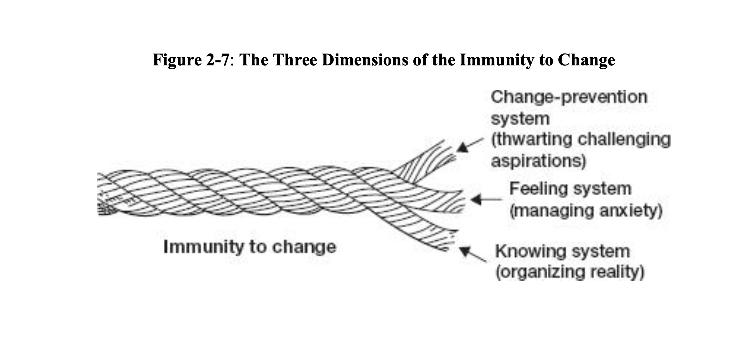
At baseline, humans are immune to change!
Inherent neurobiology: comfort with patterns—familiar = safe
Anxiety when the outcome of action or inaction is not known
How we organize reality—often based on past experiences
From Immunity to Change. R. Kegan and LL Lahey
Notes:
The change prevention system: The internal mental constructs we have about to prevent harm (at a fundamental level...loss of life or loss of love; in modern thinking perhaps loss of a job or loss of a relationship.
The feeling system: normal anxiety (and all the physiological changes that come with this) when the outcome of actions or a situation is not known. This is typically in response to the dangers we know or we THINK we know
The knowing system: is the way we organize reality (which may or may not reflect all aspects of what is!) There is always a lens through which we know something based on past experiences. The trick is to become aware of the lenses we are using and be curious (and maybe suspicious about them!)

Slide 5
What might get in the way?
Resource gap
Competing commitments
Stages of change (precontemplation-contemplation-action-maintenance-termination)
Old stories
Inner critic

Slide 6
Immunity to change model
Commitment/Goals
Doing/not doing instead
Hidden competing commitments
Big Assumptions

Slide 7
Immunity to change model
Commitment/Goals
Doing/not doing instead
Hidden competing commitments
Big Assumptions
What you say you want or will do
Notes:
These are the visible goals you have

Slide 8
Immunity to change model
Commitment/Goals
Doing/not doing instead
Hidden competing commitments
Big Assumptions
This is what you discover
When you step back and reflect
keep going deeper!

Slide 9
Immunity to change model
Commitment/Goals
Doing/not doing instead
Hidden competing commitments
Big Assumptions
This is the immunity...like the thoughts in the CTFAR model!
Notes:
These are linked...one is the competing commitments
And then the assumptions you are making about them.

Slide 10
Immunity to change model
Key element for coaching
Commitment/Goals
Doing/not doing instead
Hidden competing commitments
Big Assumptions
Test assumptions
Moving to action
Doing experiments
Notes:
The experiments are to test out if those assumptions that are driving the competing commitments which are driving the doing/not doing instead are actually valid!
Once you get to the assumptions, then you can figure out strategies to work effectively and achieve your goals!

Slide 11
The immunity “X-ray”
Go Deeper!
Underlying driver
Commitment | Doing/Not Doing | Competing Commitments | Big Assumptions
Worry box:
Tests I will do:

Slide 12
The immunity “X-ray” worked example
Commitment | Doing/Not Doing | Competing Commitments | Big Assumptions
I will learn to play guitar. I have wanted to have some music in my life, I’ve got a guitar and I can read music. | I practice intermittently for a short time—several weeks; get stuck and then just look at the guitar and feel like I should be doing it (guilty). I don’t feel happy when practicing; it feels like work! | I have other interests and I am tired so don’t practice; would rather hike when it is nice outside. It must be when I am at home alone. | I have to play for other people there is a certain way of practicing (like being in band) that is needed I won’t be good enough (for whom???)
Worry box: I won’t be good enough; no one will like the music; it will be awful! I get nervous playing in front of others.
Tests I will do: Tell myself that it is just for me when I am playing; tell others that I am just learning for myself; only play when it feels fun; have the goal to get callouses on my fingers—first step to being able to play more.

Slide 13
Immunity to change model is a framework for questions and exploration You can use it real time, proactively, after the fact or as a reflection tool

Slide 14
Practice and Experiment!

Slide 15
Next time...
December 10, 2024 12 pm ET
December 11, 2024 3 pm ET
Topic Giving Feedback and Coaching
Send us your dilemmas (ssmit1@uw.edu or LLEGGIO@augusta.edu)..will bring them forward for discussion in 2025!

Slide 16
Annotated bibliography
Immunity to Change—Robert Kegan and Lisa Laskow. | A step by step model of exploring resistance in ourselves and in our organizations. Easy to understand examples (including a medical school not changing their curriculum!). Builds heavily on the thought model approach to coaching.

